Slide 1
New EM210_AV

Slide 2
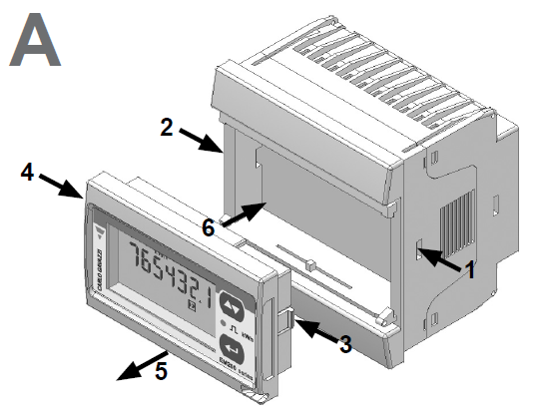
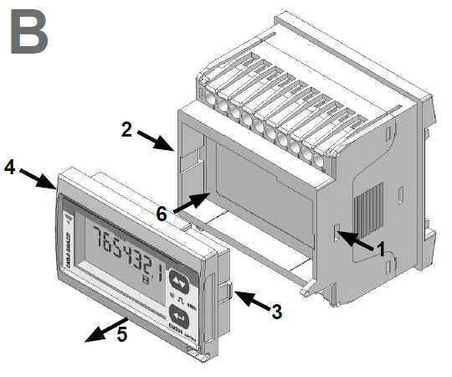
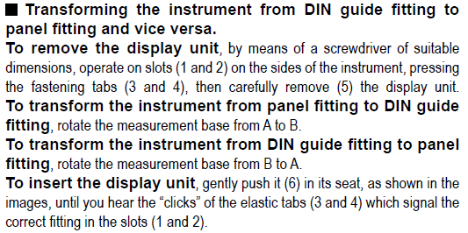
EM210 – Housing
EM21=EM210
No difference!

Slide 3
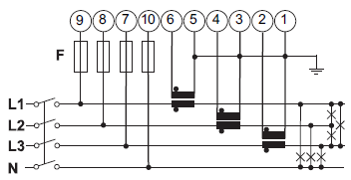
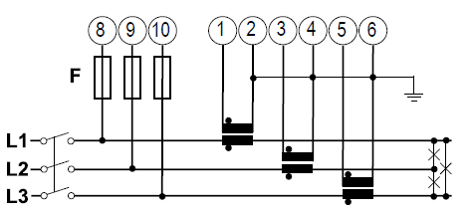
EM210_AV – New features
Measurement on three-phase systems without neutral (always self-power supply)
EM21_AV
EM210_AV
Mandatory connection!
(supply between L1 and N)
Neutral not required
(supply between L2 and L3)
Notes:
Aggiunte features

Slide 4
EM210_AV – New features
High serial communication speed
Selectable parity mode and selectable stop bit
EM21_AV
9.6 kbps
No parity
1 stop bit
EM210_AV
9.6 - 19.2 - 38.4 - 57.6 - 115.2 kbps
None or even parity
1 or 2 stop bit
Notes:
Aggiunte features

Slide 5
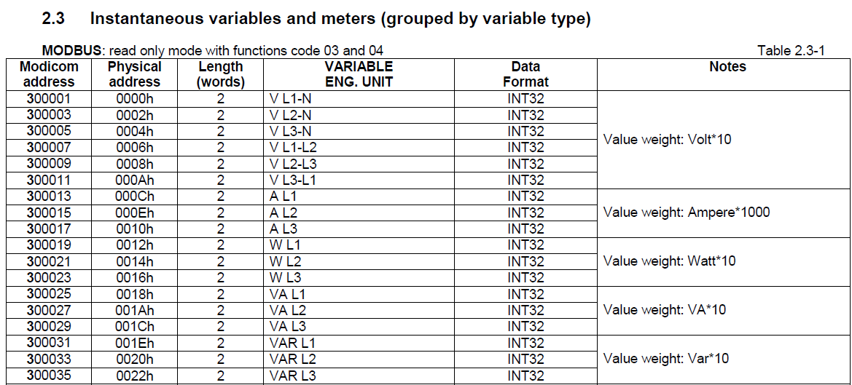
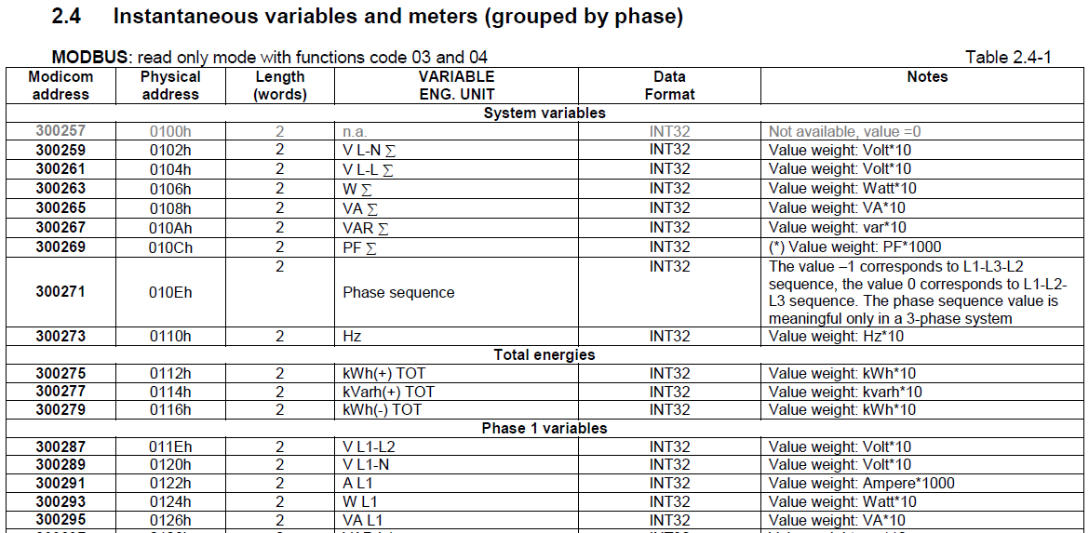
EM210_AV – New features
New protocol compatible with all other coming CG meters
Notes:
Aggiunte features

Slide 6
EM210_AV – New features
Exported (negative) kWh meter in new E application; new F application too
EM21_AV
Notes:
Aggiunte features

Slide 7
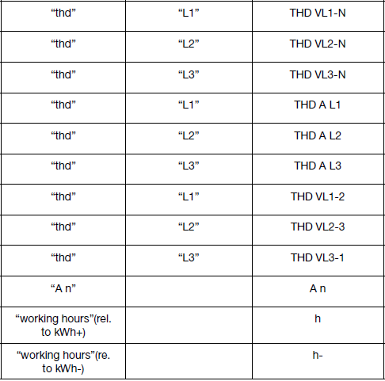
EM210_AV – New features
Voltages and currents THD measurements, current neutral (calculated), working hours
Notes:
Aggiunte features

Slide 8
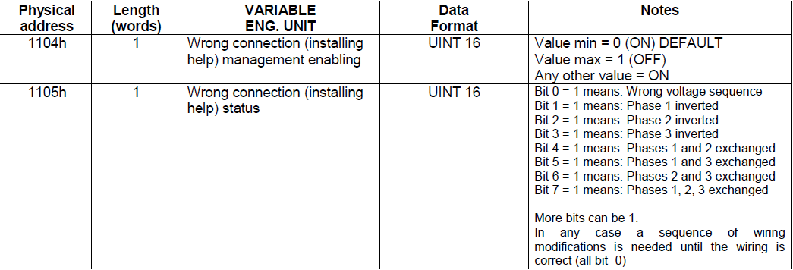
EM210_AV – New features
Wrong connection function (available over communication port) (1/2)
Enabling, disabling
Detection of wrong voltage phase sequence
Detection of wrong secondary current connection
Detection of wrong association between phase voltage and phase current
Notes:
Aggiunte features

Slide 9
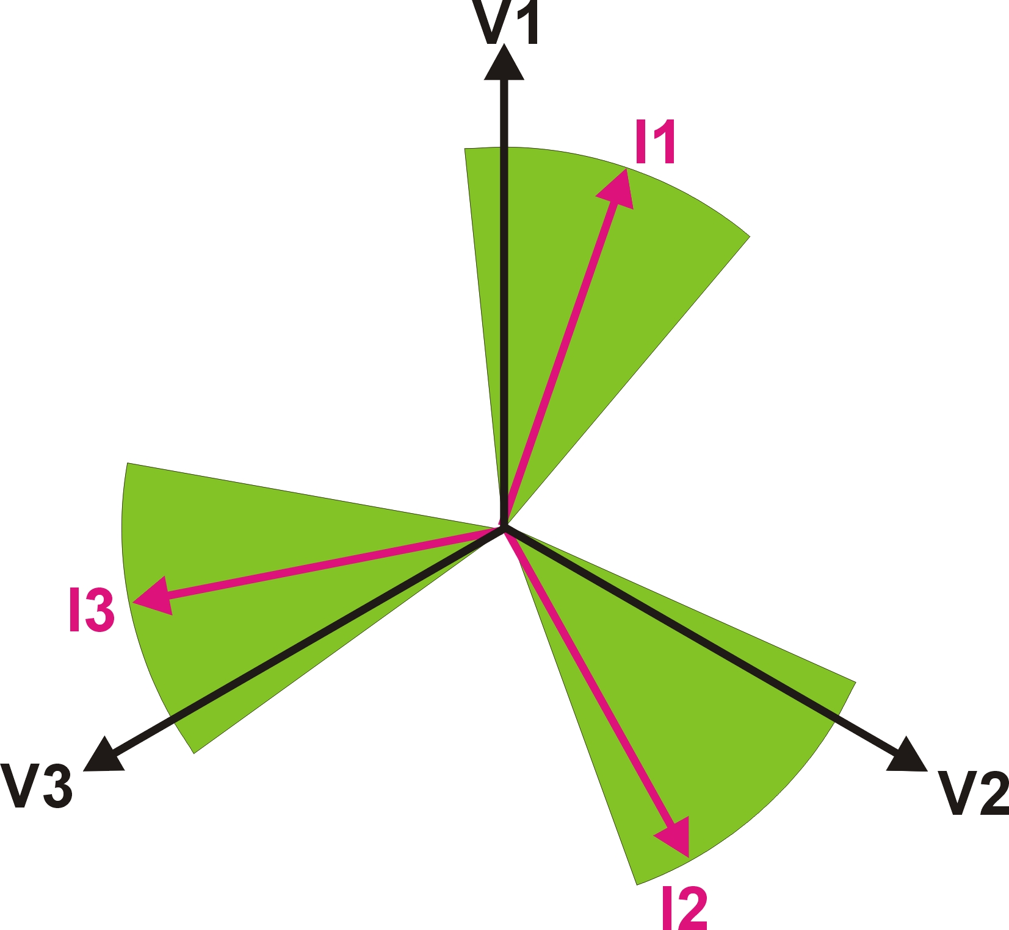
EM210_AV – New features
Wrong connection function (available over communication port) (2/2)
The algorithm works with loads whose PF
is between 0.77L and 0.99C
Notes:
Aggiunte features

Slide 10
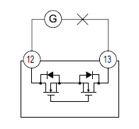
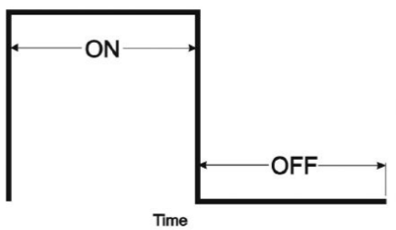
EM210_AV – New features
Selectable pulse duration
TON selectable: 30 ms or 100 ms
(according to EN62052-31)
Opto-mosfet output
(linked to +kWh)
TOFF ≥ 120 ms
(according to EN62052-31)
Notes:
Aggiunte features

Slide 11
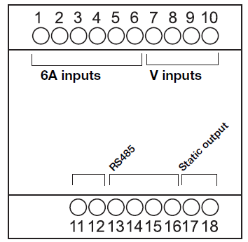
EM210_AV – New features
New terminals position for better error-proof connection
EM21_AV
I1 I2 I3 (N L)
In Out In Out In Out N L1 L2 L3
EM210_AV
EM210_AV
Notes:
Aggiunte features

Slide 12
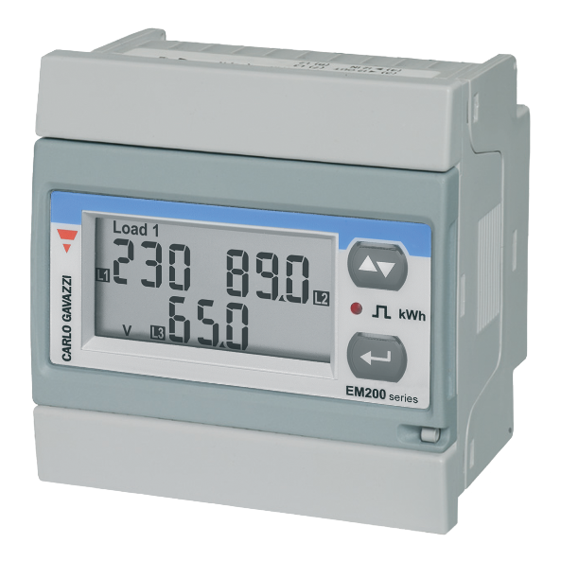
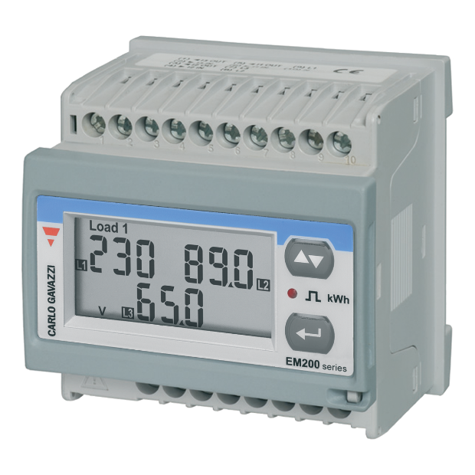
EM210_AV – Main features
External current transformer connection (5A)
Full set of variables available to perform a complete load analysis
Energy measurement kWh (total imported active energy, total exported active energy) and total reactive energy for an accurate cost allocation
Easy connections management
One digital outputs and RS485 communication port for quick and easy data transmission to PC/PLC for full load control or integration to BMS
Detachable display
Multi-use housing: for both DIN-rail and panel mounting applications
Power supply: self power supply from 40V to 480VAC (connection VL2-L3)

Slide 13
EM210_AV – Main features
Key Specifications
Housing (H x W x D): 72x72x64.6 mm
Display type: LCD, 2 lines: 1st line:7-DGT, 2nd line:3-DGT + 3-DGT
Instantaneous variables: 3 x 3 DGT
Energy variables: 1x 5+2DGT, 6+1DGT, 7 DGT
Accuracy: W-VA-PF: ±(1% RDG+2DGT); var: ±(2% RDG+2DGT);
V LN-A: ±(0.5% RDG+1DGT), kWh: Class B (EN50470-3), Class1 (EN62053-21);
kvarh: Class 2 (EN62053-23).
System type: Unbalanced: 2-3-phase; 1-phase
Voltage inputs (Un): 120/230VLLAC (AV6 model)
400VLLAC (AV5 model)
Current inputs (In): In: 5AAC, Imax: 6AAC (shunt input technology)
Method: TRMS
Digital Pulse Output: Proportionate to measured active energy (EN62052-31)
Serial Communication Port: RS485 (2-wire, Modbus), RTU protocol (Baud-rate 9.6, 19.2, 38.4, 57.6, 115.2 kbps)
Power supply: Self power supply (from 40V to 480VAC through terminals VL2-L3)
Temperature range: operating: -25°C to +55°C;
storage: -30°C to +70°C
Approvals: CE, cULus listed
Protection degree: IP50 (front)

Slide 14
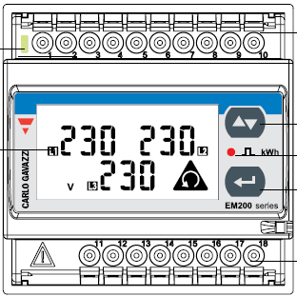
EM210_AV – Wiring
Phase 1
Phase 2
Phase 3
1
2
The use of external
current transformers
is mandatory
3
4
5
6
LOAD
Neutral

Slide 15
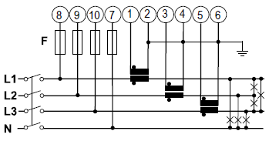
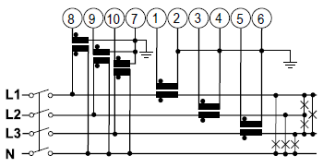
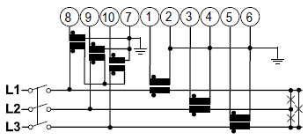
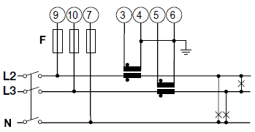
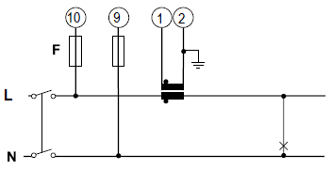
EM210_AV – Wiring
New
3-phase + N unbalance sys
(3 CT connection)
3-phase + N unbalance sys
(3-CT + 3-VT connection)
3-phase without N unbalance sys
(3-CT connection)
3-phase without N unbalance sys
(3-CT + 3-VT connection)
2-phase + N unbalance sys
(2-CT connection)
2-phase + N unbalance sys
(2-CT + 2-VT connection)
L1
L2

Slide 16
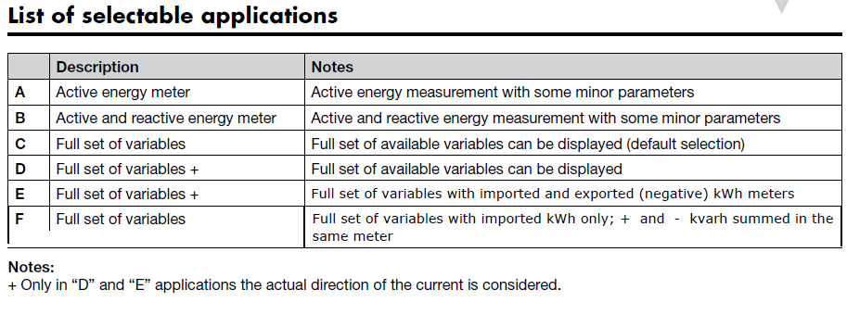
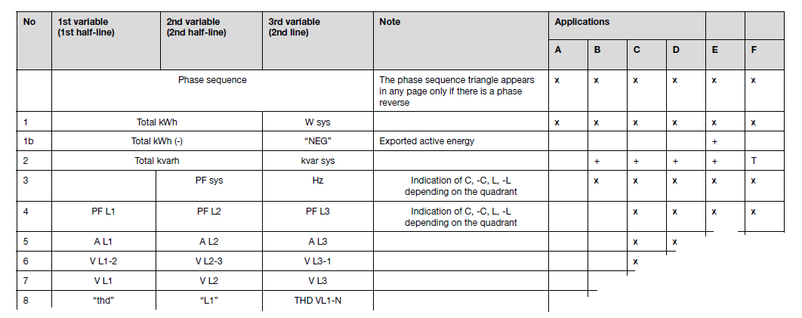
EM210_AV – Applications
New

